Slide 1
Low-Resource Named Entity Recognition using Information Retrieval and In-Context Learning
Enzo Shiraishi¹, Raphael Y. Camargo¹, Henrique Luiz Pereira da Silva², Ronaldo C. Prati¹
ronaldo.prati@ufabc.edu.br
¹Federal University of ABC (UFABC)
²University of São Paulo (USP)
Notes:
Introduzir você mesmo, os orientadores, e o nome do artigo

Slide 2
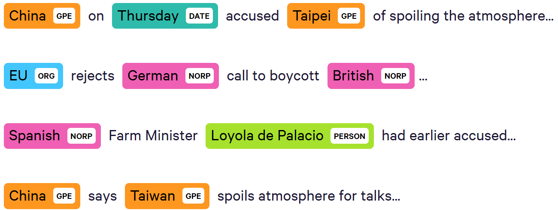
Named Entity Recognition
Fonte: Introduction to the CoNLL-2003 Shared Task: Language-Independent Named Entity Recognition
Notes:
Uma tarefa muito parecida com o raciocínio simbólico é NER, que encontra segmentos no texto que mencionam entidades do mundo real que pertencem a classes denominadas nomes

Slide 3
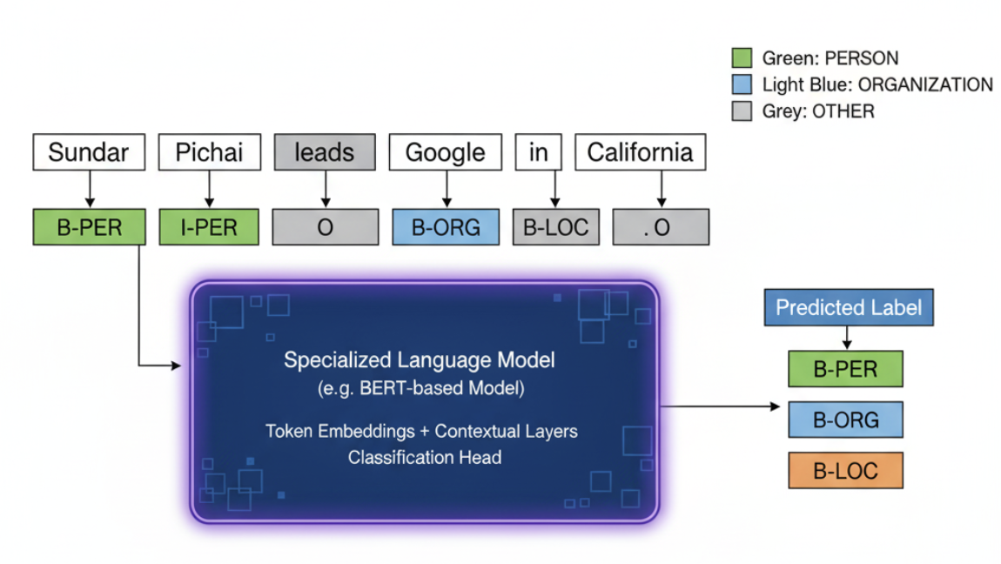
State of the art - Token classification
Notes:
Hoje o estado da Arte de NER são modelos de linguagem autocodificadores que usam classificação de tokens, onde o modelo aprende a classificar a classe do próximo token da sequência (B: inicio ou no meio de entidade, I inside entidade as vezes, o outside ou sem entidade). Essa técnica tem performance muito boa mas é inviável para usar in-context por causa da formulação do modelo, então precisamos de um jeito de fazer NER bem usando in-context para ter o melhor dos 2 mundos

Slide 4
Drawbacks of token classification
Requires aditional training for the downstream task
For training, it is necessary to have (a considerable set) of labelled data
When new data or new language model is available, it is necessary to retrain the model
Models are specific to the downstream domain

Slide 5
In Context Learning NER
Instruct an LLM to find entities using only the prompt.
Provide a few examples (few-shot) directly in the prompt.
No fine-tuning needed. The model learns "on the fly."
Pros:
Fast Prototyping
Few Trainint data
Highligh flexible
Cons:
Prompt sensitivity
Lower Accuracy

Slide 6
Information Retrieval for NER
Our method uses a retrieval system to find relevant examples on the fly
When a new query arrives, we searches the database for the examples that are most similar to the query
These dynamically retrieved examples are inserted into the prompt
Examples are tailored specifically to each new query

Slide 7
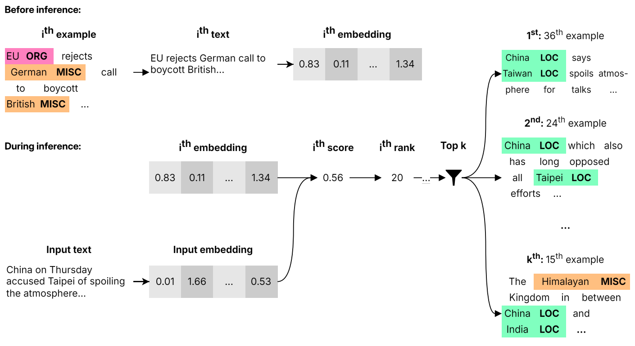
Our method

Slide 8
Which IR method to choose?
We experiment with different IR methods for creating the prompts
Mechanism | Description | Hyperparameter(s)
Fixed | Constant examples | None (baseline)
Random | Random examples | None (baseline)
BM25 | BM25 [1] | k1​,b
SS | Semantic search with dense embeddings [2] | embedding model
MMR | Semantic search with Maximal Marginal Relevance [3] | λ
RRF | Reciprocal Rank Fusion of BM25 and SS [4] | C
[1] https://doi.org/10.1561/1500000019
[2] https://aclanthology.org/D19-1410/
[3] https://doi.org/10.1145/290941.29102
[4] https://doi.org/10.1145/1571941.1572114

Slide 9
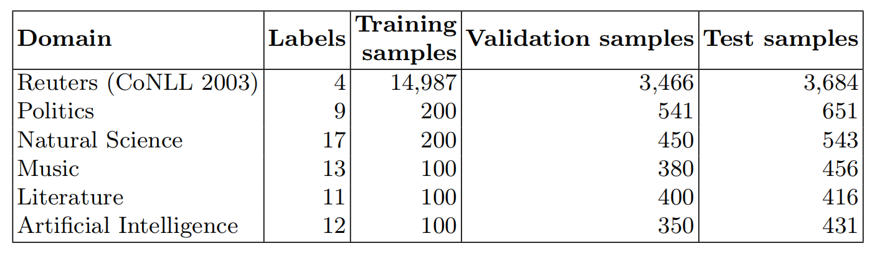
Experimental evaluation
Number of retrieved examples: 1 to 25
Sentence embedding: bge-large-en-v1.5
LLMs: gemini-1.5-pro-001 (full analysis) and gpt-4o-2024-05-13 (besta configurations)
Dataset: CrossNER collection:

Slide 10
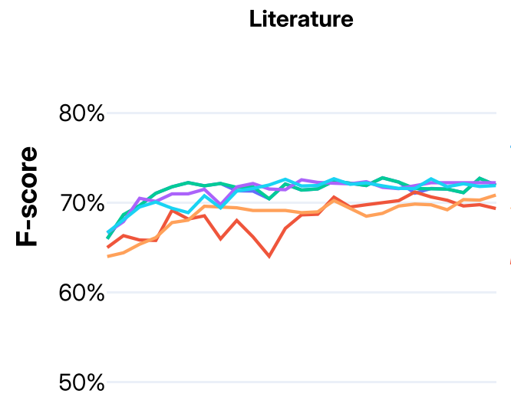
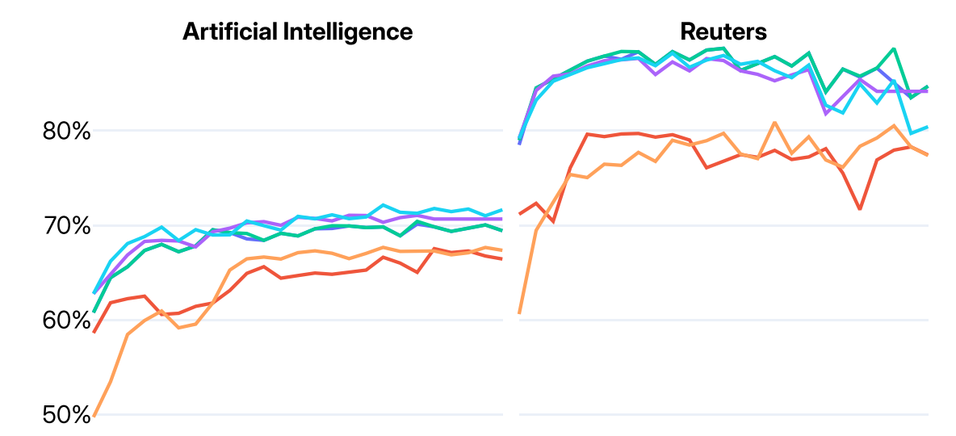
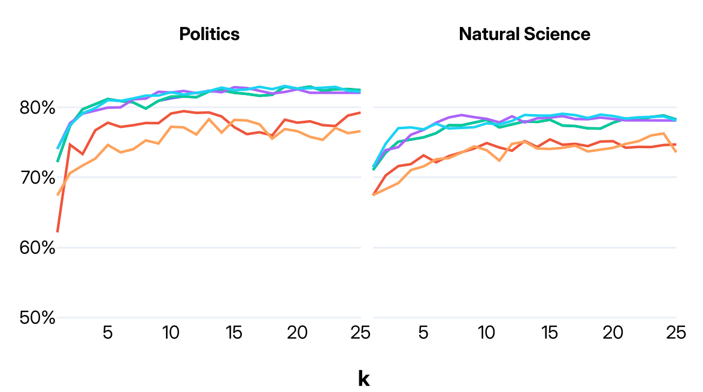
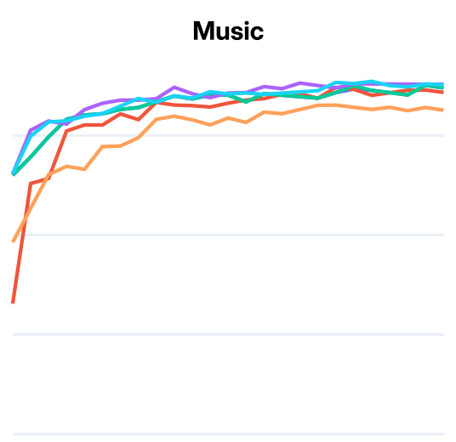
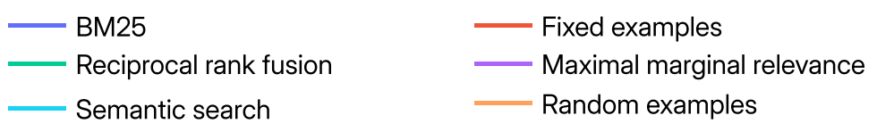
Results (with gemini-1.5-pro)

Slide 11
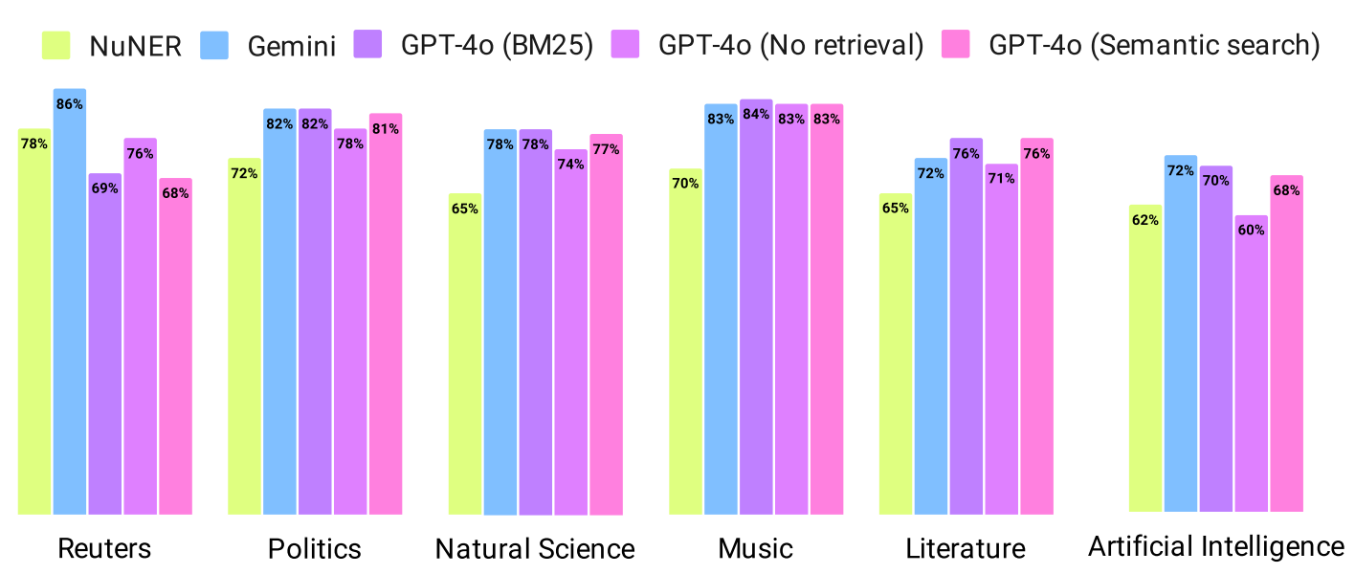
Comparison with GPT-4o (same k from best gemini)

Slide 12
Conclusion
We propose A novel framework was proposed that successfully combines Information Retrieval (IR) and In-Context Learning (ICL) to enhance Named Entity Recognition (NER) using LLMs
Dynamically selecting examples for the prompt significantly boosts performance.
State of the art performance in the low-resource CrossNER data set
The approch is model agnostic, and does not require fine-tunning a language model

Slide 13
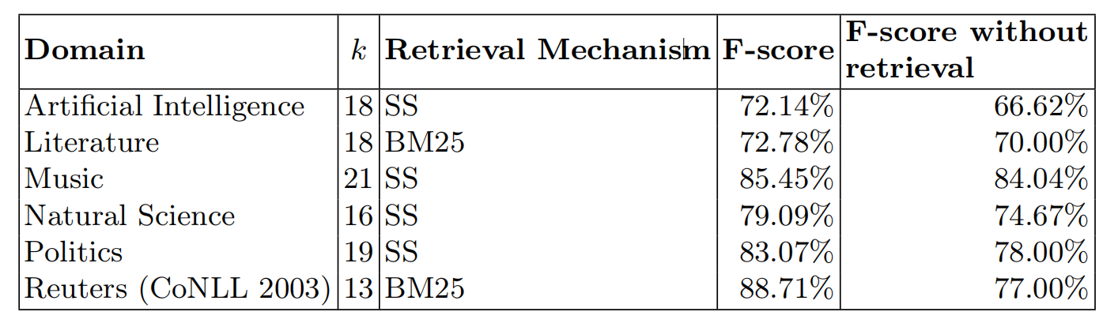
Results from the validation data set

